Slide 1
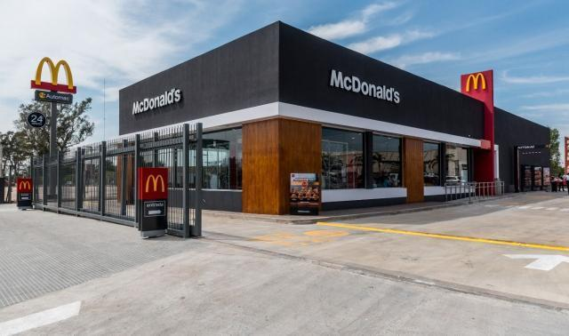
IBM Data Science Capstone
Opening a new McDonald´s franchise in CABA, Argentina

Slide 2

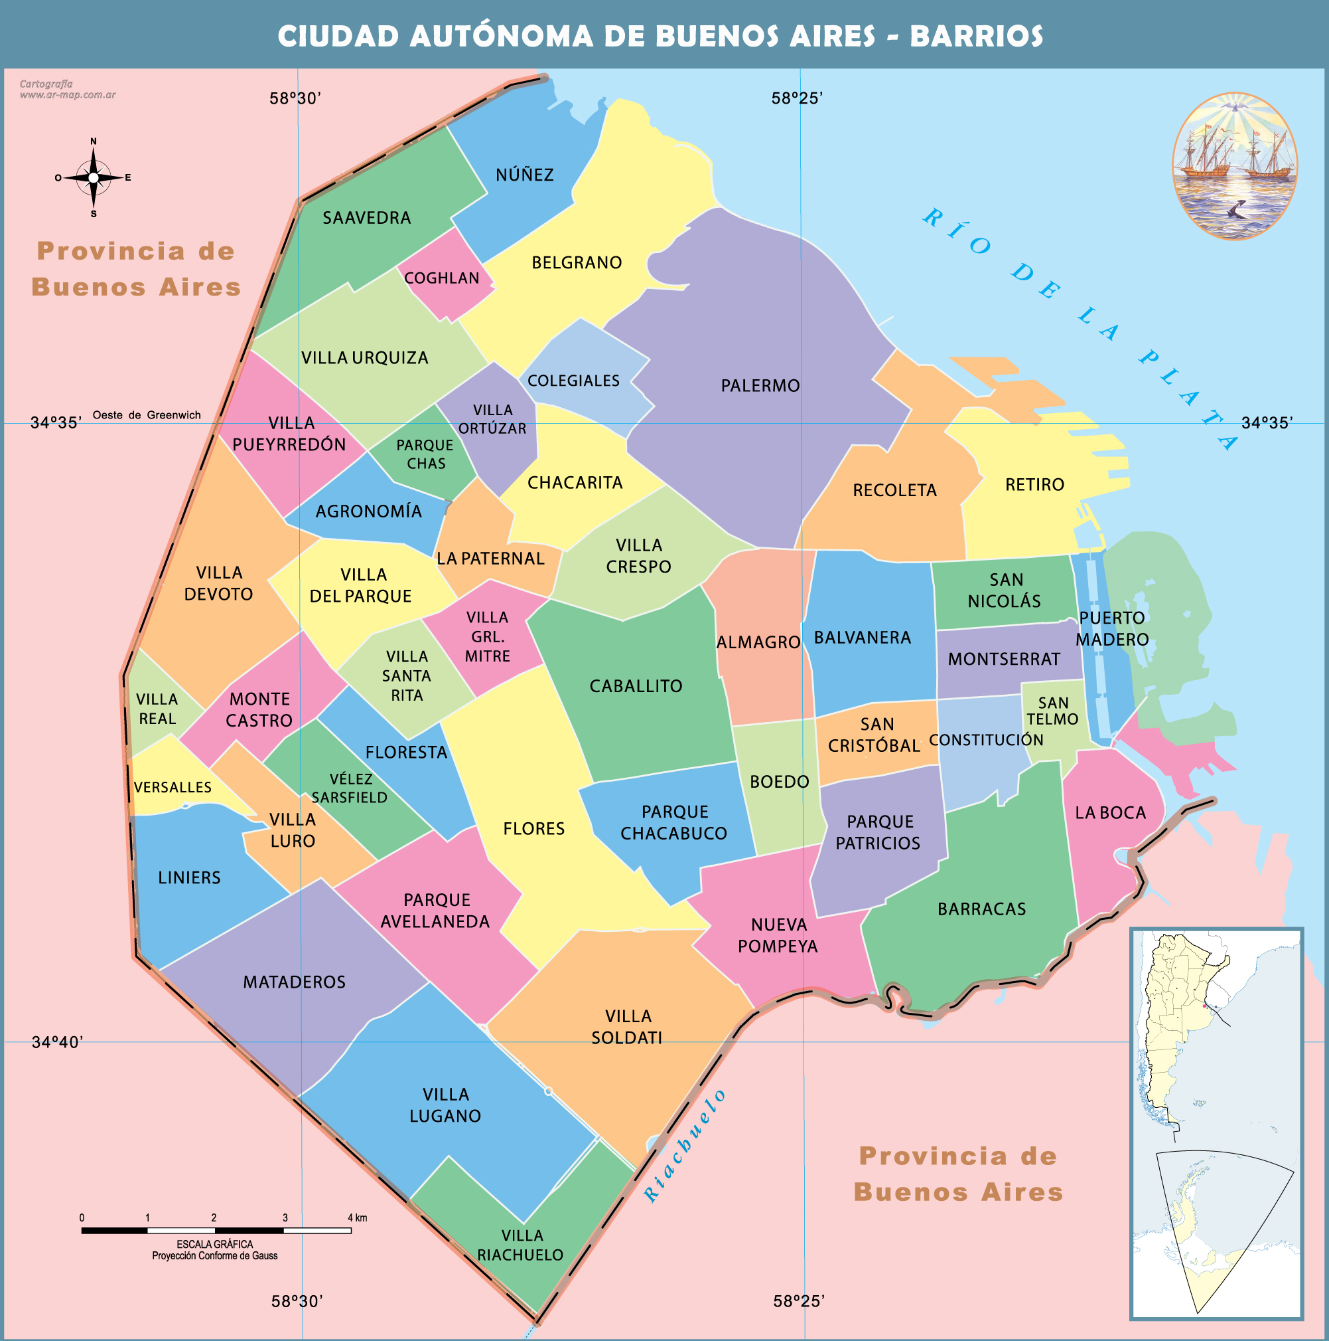
Introduction
CABA is the most popular and populated city in Argentina made of 48 neighborhoods.
McDonald´s is the most popular Fast Food Restaurant franchise in the world.
In this final Capstone I am going to analyze which naighborhood in CABA is the best to open a new McDonald´s franchise.
To do that i´m using K-Means Clustering in order to get relevant information about the neighborhoods.

Slide 3

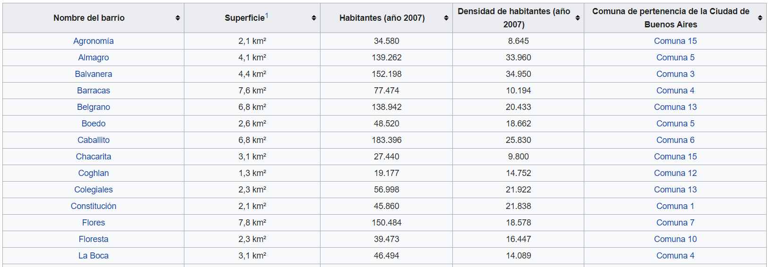

Data

Slide 4
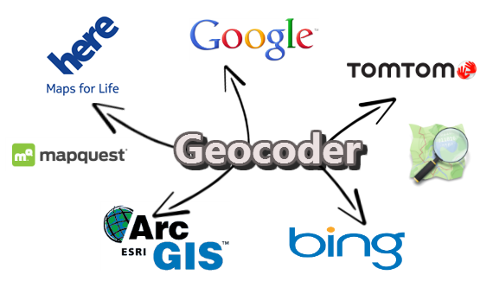

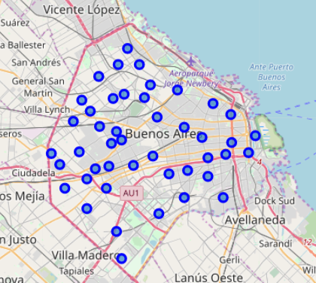
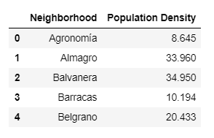
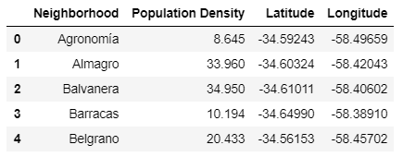
Methodology

Slide 5
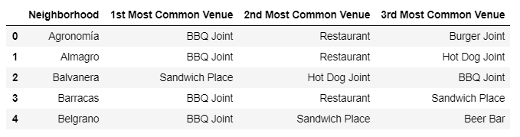
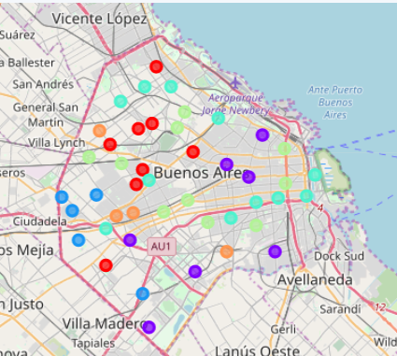
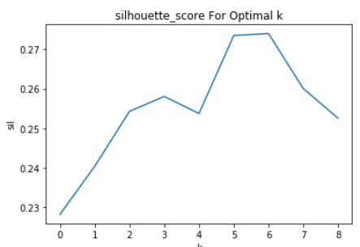
Optimal value of K = 6

Slide 6
Results
Cluster 1: The most common venues are BBQ Joint and Restaurants.
Cluster 2: The most common venues are BBQ Joint, Restaurants and Sandwich Places.
Cluster 3: The most common venues are Fast Food Restaurants and Sandwich Places.
Cluster 4: The most common venues are BBQ Joints and Sandwich Places.
Cluster 5: The most common venues are Restaurants and Burger/Beer Bars.
Cluster 6: The most common venues are BBQ Joints
Cluster 1 or Cluster 6

Slide 7
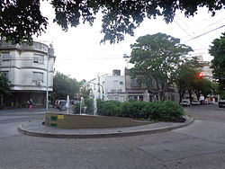
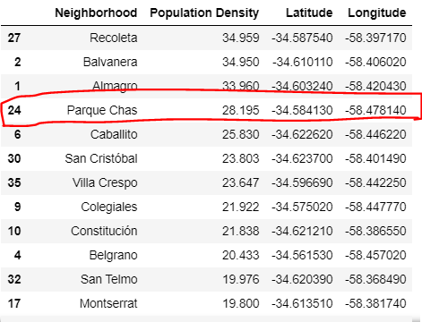
Conclusion

